Slide 1
Large Language Models for Generative AI
Dr. Monali Mavani

Slide 2

Large Language Models for Generative AI
Disclaimer and Acknowledgement
The content for these slides has been obtained from books and various other source on the Internet
I here by acknowledge all the contributors for their material and inputs.
I have provided source information wherever necessary
I have added and modified the content to suit the requirements of the course
Many slides are adopted from course notes of Zhou, S. (2026). Transformers in Practice. DeepLearning.AI

Slide 3
LLM Optimization
Two-phase inference process
KV-Caching
Inference Bottleneck
Speculative decoding
PagedAttention

Slide 4
LLM Inference Efficiency
Why efficiency matters: training is one-time cost, inference is repeated many times
What governs efficiency?
Training (supervised): you see all tokens, can parallelize over sequence (matmul in Transformer)
Inference: you have to generate sequentially, can't parallelize over generation, so harder to fully utilize compute

Slide 5
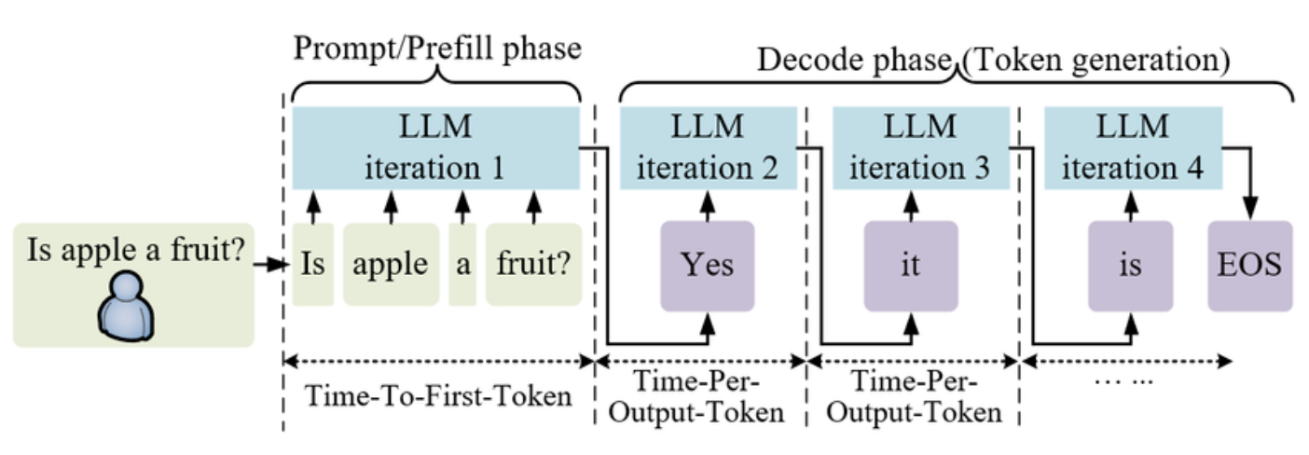
Two-phase inference process
Phase | What happens | Batch behavior
Prefill | Entire prompt processed at once | Compute-bound, parallelizable across tokens
Decode | One new token generated per step, Use attention keys & values of all previous tokens | Memory-bandwidth-bound, serial per request
Image credits: https://huggingface.co/blog/Kseniase/inference

Slide 6
KV cache

Slide 7
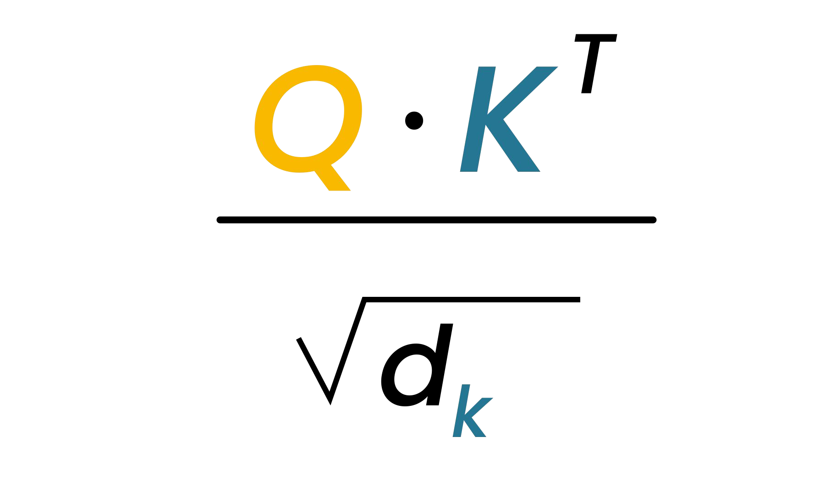
QKV calculations
Output: The dog bit…
Q⋅K^{T}
K
The dog bit
A = softmax(
The dog bit
)
V
q₁ k₁ ⋅
q₂ k₁ ⋅ | q ⋅ _{k}2 2
q₃. k1 | q ⋅ _{k}3 2 | q ⋅ _{k}3 3
ª11
ª21 | ª22
ª31 | ª32 | ª33
v₁
v₂
v₃
The
The
The
Q
dog
dog
*
dog
the
bit
bit
bit
attention weights

Slide 8
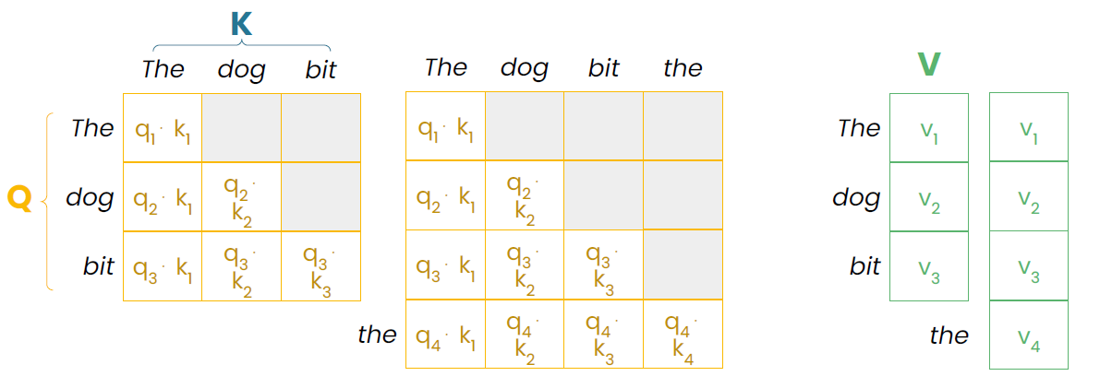
Past KVs don’t change
Output: The dog bit the…

Slide 9
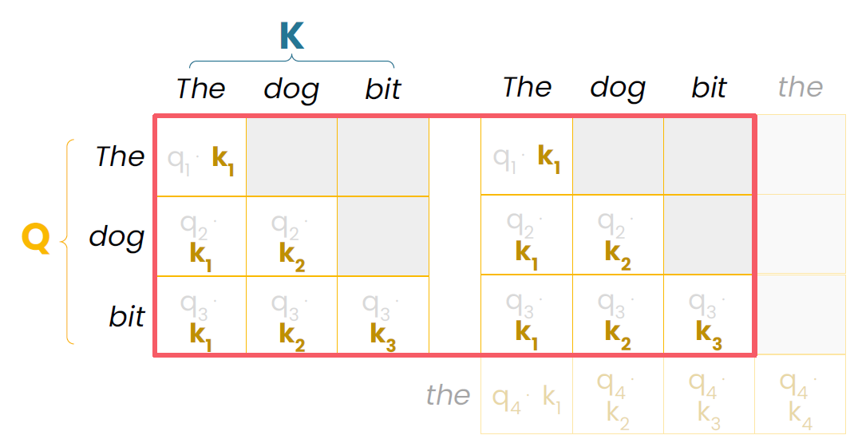
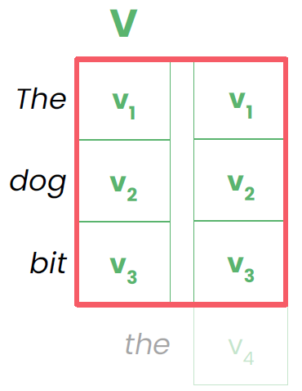
Past KVs don’t change
Output: The dog bit the…
Cache reusable values!
What about Q? →
Output: The dog bit …
q₃

Slide 10
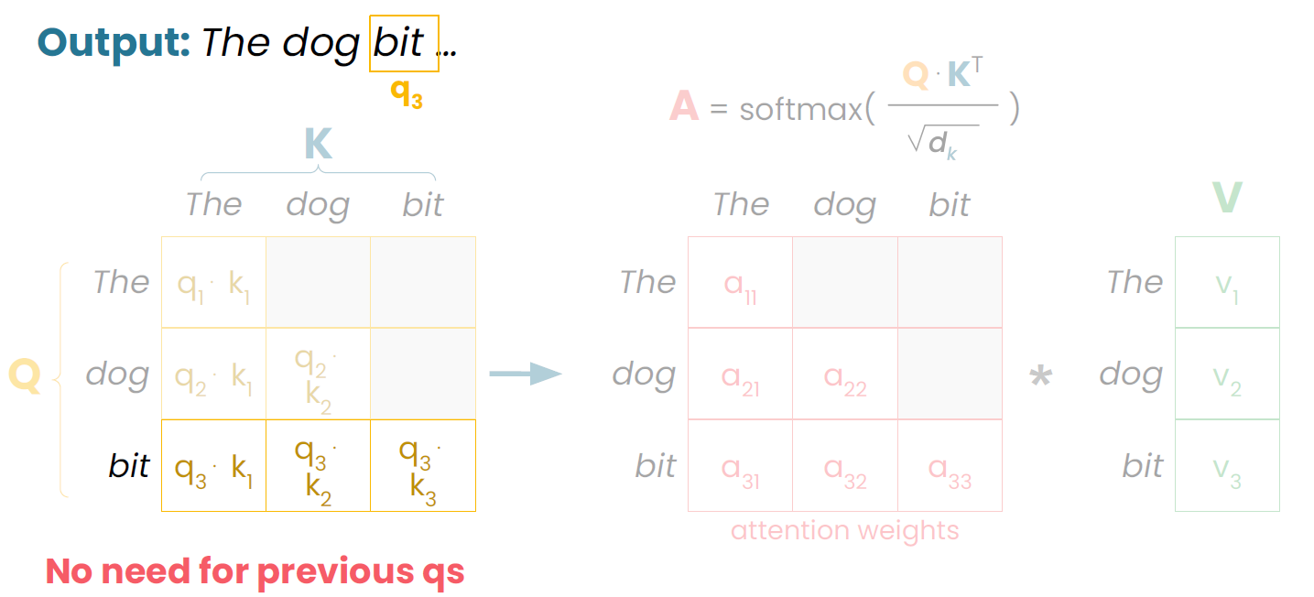
What about Q?

Slide 11
QKV calculations
New Tokens:
Compute QKV
Store K & V:
They don’t change as new tokens arrive

Slide 12
One KV cache per attention layer
Output
Transformer block
Transformer block
Transformer block
Add
Add
Add
Feed forward
Feed forward
Feed forward
Layer norm
Layer norm
Layer norm
Add
Add
Add
Attention
KV
Attention
KV
cache
Attention
KV
cache
cache
Layer norm
Layer norm
Layer norm
Input

Slide 13
KV Cache
KV Cache
The dog bit The dog bit the _{V}
The _{The}
dog _{dog}
bit _{bit}
⋅ q ⋅ q ⋅
_{⋅ k} ^{q}4 4 4
^{q}4 1 k₂ k₃ k₄ the v₄
q₁ k₁ ⋅ |  |  |  | q₁ k₁ ⋅
q ⋅ k 2 1 | q ⋅ 2 k₂ |  |  | q ⋅ k 2 1 | q ⋅ 2 k₂
q ⋅ k 3 1 | q ⋅ 3 k₂ | q ⋅ 3 k₃ |  | q ⋅ k 3 1 | q ⋅ 3 k₂ | q ⋅ 3 k₃
v₁ |  | v₁
v₂ |  | v₂
v₃ |  | v₃
KVs: Token 4 “the”
KVs: Token 3 “bit”
KVs: Token 2 “dog”
KVs: Token 1 “The”

Slide 14
How KV cache builds
Phase 1: Prefill
KV Cache
LLM
The dog bit the…
KVs: Token 4 “the”
KVs: Token 3 “bit”
KVs: Token 2 “dog”
KVs: Token 1 “The”
per attention layer

Slide 15
How KV cache builds
Phase 2: Decode
KV Cache
LLM
The dog bit the…
man
KVs: Token 5 “man”
KVs: Token 4 “the”
KVs: Token 3 “bit”
KVs: Token 2 “dog”
KVs: Token 1 “The”

Slide 16
How KV cache builds
Phase 2: Decode
KV Cache
LLM
The dog bit the man
twice
KVs: Token 6 “twice”
KVs: Token 5 “man”
KVs: Token 4 “the”
KVs: Token 3 “bit”
KVs: Token 2 “dog”
KVs: Token 1 “The”

Slide 17
How KV cache builds
Phase 2: Decode
KV Cache
LLM
The dog bit the man twice
today
KVs: Token 7 “today”
KVs: Token 6 “twice”
KVs: Token 5 “man”
KVs: Token 4 “the”
KVs: Token 3 “bit”
KVs: Token 2 “dog”
KVs: Token 1 “The”

Slide 18
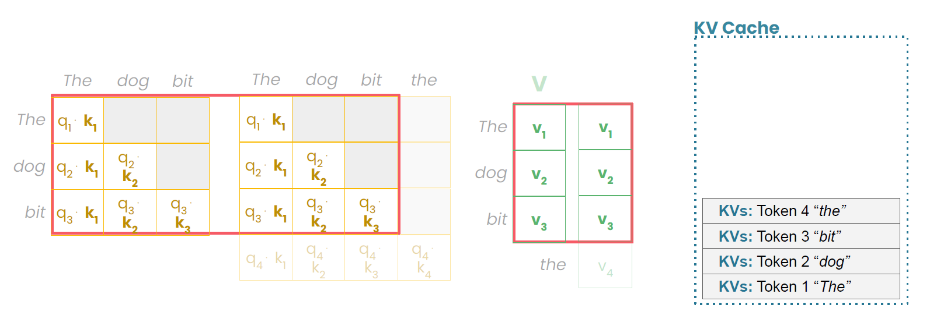
KV Cache
Keys and values of the initial prompt and every subsequently generated token are saved in KV cache inside GPU memory to avoid redundant calculations in future steps
First output token, we start with an initially empty KV cache and need to calculate as many sets of key and value vectors as there are tokens in the input prompt
For every additional output token, only one more set of key and value vectors needs to be calculated and added to the KV cache
Computational efficiency increases: With a cache, each key and value is computed once and then reused, reducing the total per-step complexity to linear
Memory usage increases linearly: Each new token appends to the KV cache. For long sequences and larger LLMs, the cumulative KV cache grows larger, which can consume a significant GPU memory

Slide 19
Inference Bottleneck

Slide 20
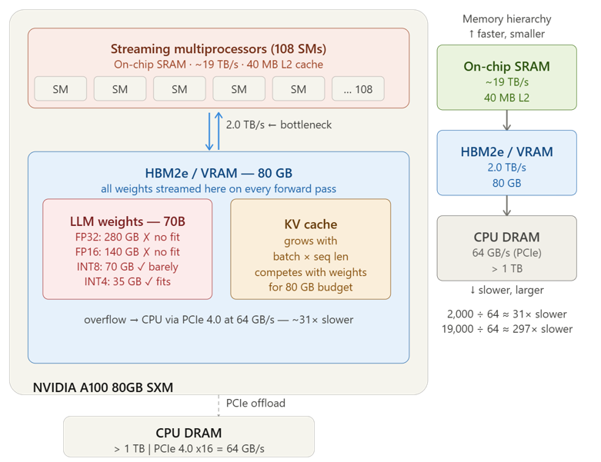
GPU architecture

Slide 21
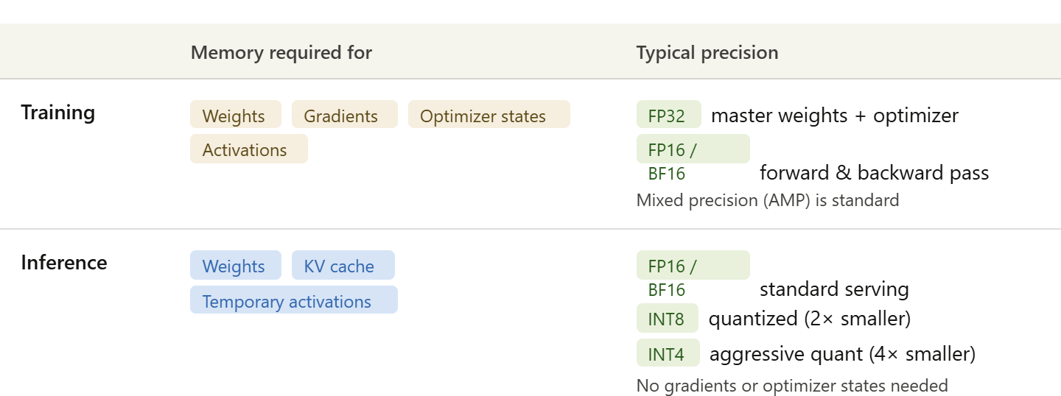
Memory requirements
Training needs FP32 for optimizer states (Adam stores first and second moment in full precision) even when the forward pass runs in FP16 (mixed precision training)
Training memory is higher than inference for the same model
Inference drops all of that and can go even lower with quantization

Slide 22
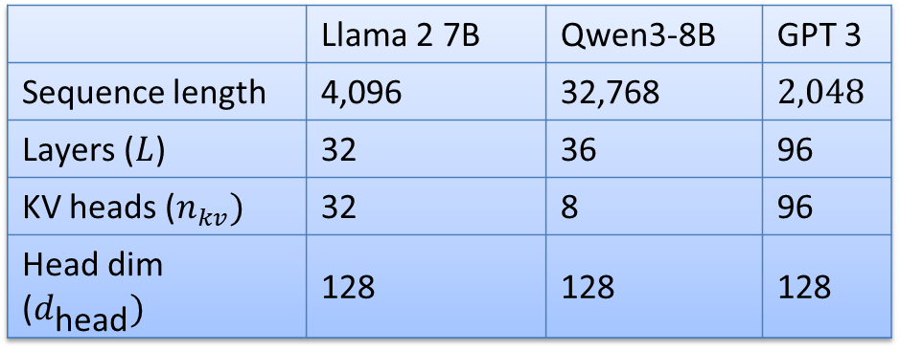
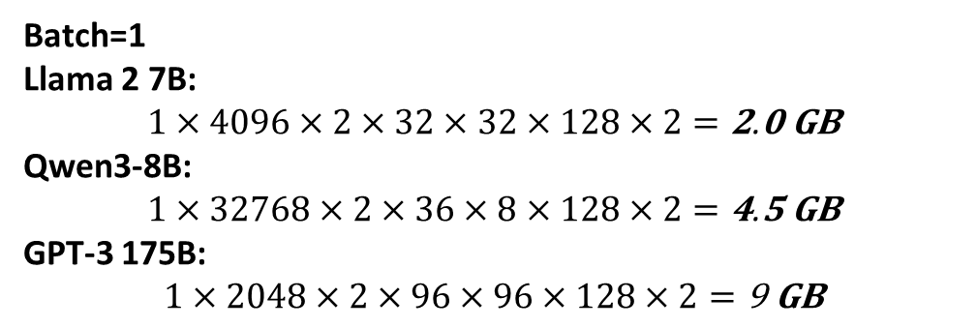
KV cache memory
Total size of KV cache in bytes = (batch_size) * (sequence_length) * 2 * (num_layers) * (Number of KV heads) * (Per-head dimension) * sizeof(FP16)
 | Llama 2 7B | Qwen3-8B | GPT 3
Sequence length | 4,096 | 32,768 | $2,048$
Layers ($L$) | 32 | 36 | 96
KV heads ($n_{kv})$ | 32 | 8 | 96
Head dim ($d_{\text{head}})$ | 128 | 128 | 128
Batch Size: No requests (users) processed simultaneously
Batch=1
Llama 2 7B:
$$1×4096×2×32×32×128×2=\text{2}\text{.}\text{0} \text{GB}$$
Qwen3-8B:
$$1×32768×2×36×8×128×2=\text{4}\text{.}\text{5} \text{GB}$$
GPT-3 175B:
$$1×2048×2×96×96×128×2=\text{9} \text{GB}$$
Despite having the shortest context of the three, GPT-3 has by far the largest KV cache
Despite Qwen3-8B having an 8× longer context, it only uses 2.25× more KV cache memory than Llama 2 7B at batch=1
— a direct payoff of GQA cutting KV heads from 32 → 8

Slide 23
Inference Memory
2 main contributors to GPU LLM memory requirement: model weights and KV cache
Weights = num_params × sizeof(dtype)
Component | Llama 2 7B | Qwen3-8B | GPT-3 175B
Parameters | 7B | 8.2B | 175B
Weights | 14.0 GB | 16.4 GB | 350.0 GB
KV Cache | 2.0 GB | 4.5 GB | 9.0 GB
Total | ~16.0 GB | ~20.9 GB | ~359.0 GB
Fits on | 1× A100 40GB | 1× A100 40GB | 5× A100 80GB minimum

Slide 24



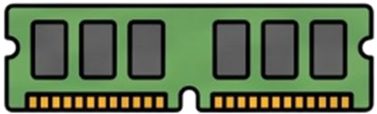
At scale : "Here's the scale of the problem"
70B Parameter Model
One forward pass
500 tokens = 500 loops
LLM
280 GB Memory (considering only weights in FP32)
Billions of calculations
A 500-token response from a 70B model: streaming 70B parameters through compute 500 times — fundamentally inference is memory-bandwidth-bound, techniques like quantization, KV caching, and speculative decoding exist

Slide 25
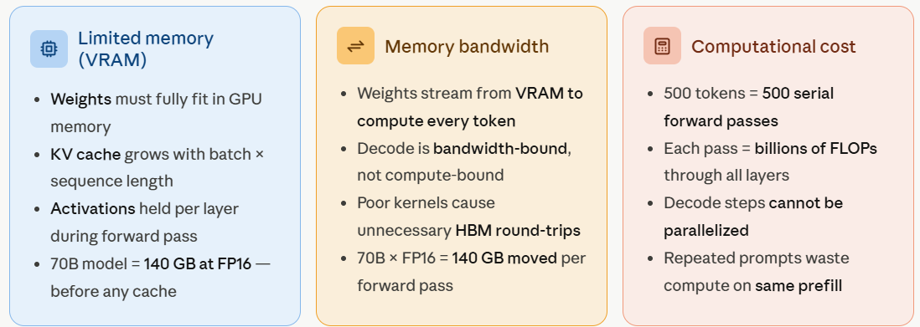
LLM inference bottlenecks : "Here's WHY it's expensive — 3 root causes"
Best real-world stack: Quantization + PagedAttention + Continuous batching
the core of vLLM and TGI inference engines
Each bottleneck has a family of solutions — Mapping next slide
Quantization attacks all three simultaneously — smaller weights use less VRAM, transfer faster, and require fewer FLOPs

Slide 26
Optimization table
Saves = which resource Phase = when it helps Set at = when you commit to it
Category | Techniques | Saves | Phase | Set at
Model-level Shrink the model | Quantization, Pruning, Distillation, Weight sharing | VRAM Bandwidth Compute | Train, Prefill Decode | Load
Attention Cheaper math | FlashAttention, Sliding window, Sparse attention | Bandwidth Compute | Train, Prefill Decode | Train Load
KV cache Smarter storage | GQA / MQA, PagedAttention, Quantized KV, Sliding window | VRAM Bandwidth | Train, Prefill Decode | Train Runtime
Token generation Faster decode | Speculative decoding, Operator fusion, Custom kernels | Bandwidth Compute | Train, Prefill Decode | Runtime
Serving Max GPU use | Continuous batching, Tensor parallelism , Pipeline parallelism | VRAM Compute | Train, Prefill Decode | Runtime
Redundancy Avoid repeat work | Prefix caching, KV reuse, Shared prompt cache | Compute | Train, Prefill Decode | Runtime

Slide 27
Generation Acceleration : Speculative Decoding

Slide 28
Memory Bottleneck in LLM Inference
Standard LLM inference: For every single token generated, the GPU has to move billions of model parameters from VRAM into the compute units, do the calculation, produce one token, then move all those parameters again for the next one.
Compute itself is fast, constant movement of data is the bottleneck
GPU underutilized for most of the inference process, generating one token at a time regardless of how obvious that next token is
E.g. Predicting "words" after "Actions speak louder than..." costs the same amount of compute as solving a complex reasoning step
Speculative decoding is an inference optimization technique that dramatically accelerates LLM text generation

Slide 29







Speculative decoding
A small, cheap draft model guesses next few tokens
Large target model then checks all the guesses in a single forward pass
We keep the guesses the target agrees with and fix the first one it doesn't.
Target Model
A small model could predict these
Draft Model
checking is cheaper
However
,
draft tokens
Target Model
resample
draft tokens
Target Model
70B Param.
Model
Draft Model
Draft Model
1B Param.
Model
Faster Less accurate
Slower More accurate

Slide 30
Fewer big-model passes
Instead of relying on a slow forward pass for every single word, you effectively get multiple tokens for the computational cost of a single verification step.
Target model only
Target Model
500 big-model passes
Speculative decoding
Target Model
Draft Model
~50%-67% reduction typical

Slide 31
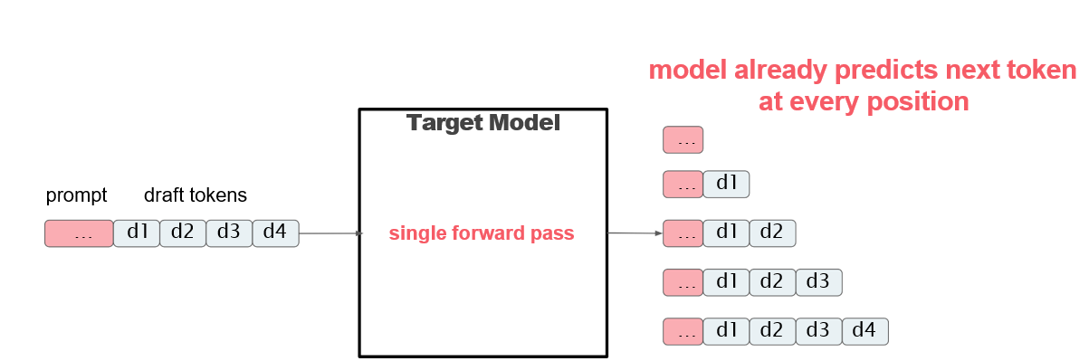
One forward pass

Slide 32
Speculative decoding
Save draft tokens and distributions
Paris . Which is
Draft Model
The capital of France is

Slide 33
How do you verify tokens?
target model: next token probabilities
…
prompt
… Paris . Which is
Target Model
… Paris
… Paris .
… Paris .
… Paris .
draft tokens
Which
Which is

Slide 34
How do you verify tokens?
target
draft model: token probabilities
…
prompt
… Paris . Which is
Target Model
… Paris
… Paris .
… Paris .
… Paris .
draft tokens
Which
Which is

Slide 35
How do you verify tokens?
target
draft
True!
if p_{tgt}(Paris) ≥ p_{drft}(Paris)
…
prompt
… Paris . Which is
Target Model
… Paris
… Paris .
… Paris .
… Paris .
draft tokens
Which
Which is

Slide 36

How do you verify tokens?
target
draft
False!
Biased coin toss
…
… Paris
… Paris .
… Paris .
… Paris .
if p_{tgt}(Paris) ≥ p_{drft}(Paris)
Target Model
p_{tgt}(Paris)
p(accept) =
p (Paris)
drft
Which
Which is
p(x) = target probability
q(x) = draft probability
Reject with probability 1 − p(x)/q(x)

Slide 37
How do you verify tokens?
Runs in parallel
if p_{tgt}(Paris) ≥ p_{drft}(Paris)
target
draft
…
…
Target Model
Paris
if p_{tgt}(.) ≥ p_{drft}(.)
… Paris .
Paris .
.
if p_{tgt}(Which) ≥ p_{drft}(Which)
…
Which
Which is
if p_{tgt}(is) ≥ p_{drft}(is)
… Paris

Slide 38
How do you verify tokens?
target
draft
Runs in parallel
…
if p_{tgt}(Paris) ≥ p_{drft}(Paris)
if p_{tgt}(.) ≥ p_{drft}(.)
if p_{tgt}(Which) ≥ p_{drft}(Which)
if p_{tgt}(is) ≥ p_{drft}(is)
Target Model
… Paris
… Paris .
Paris .
.
…
Ww hich
Which is
… Paris

Slide 39
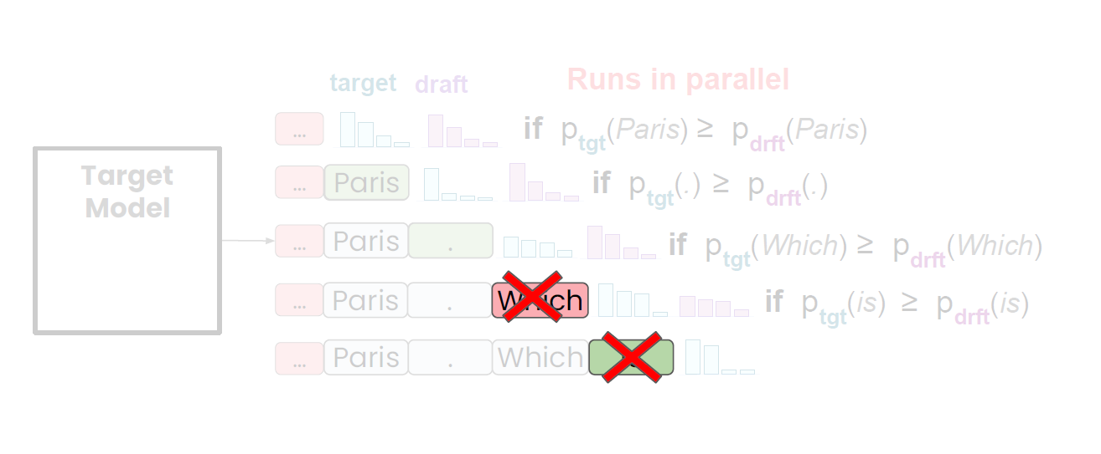
How do you verify tokens?

Slide 40
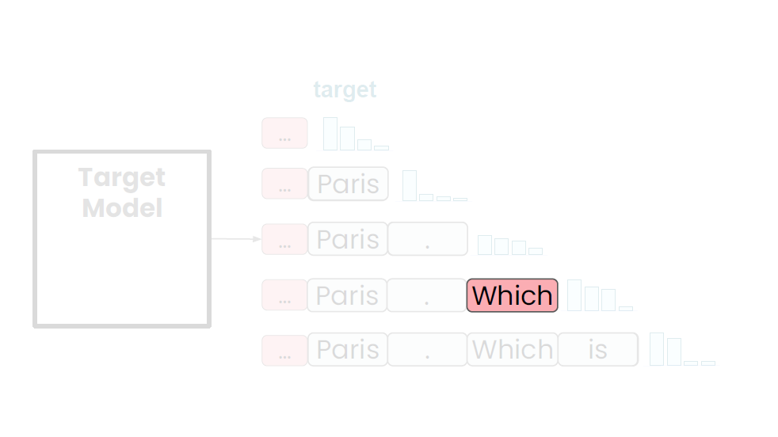
Rejected tokens

Slide 41
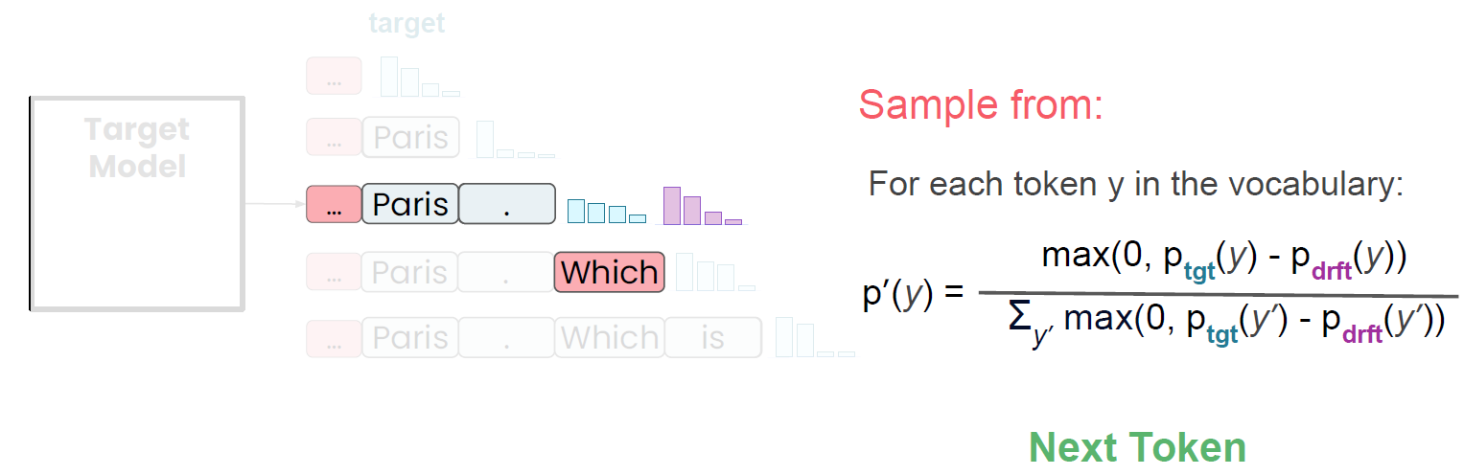
Rejected tokens
p(x) = target probability
q(x) = draft probability
$$p^{′}\left(x\right)=\text{norm}(max⁡\left(0 , p\left(x\right)−q\left(x\right)\right))$$

Slide 42
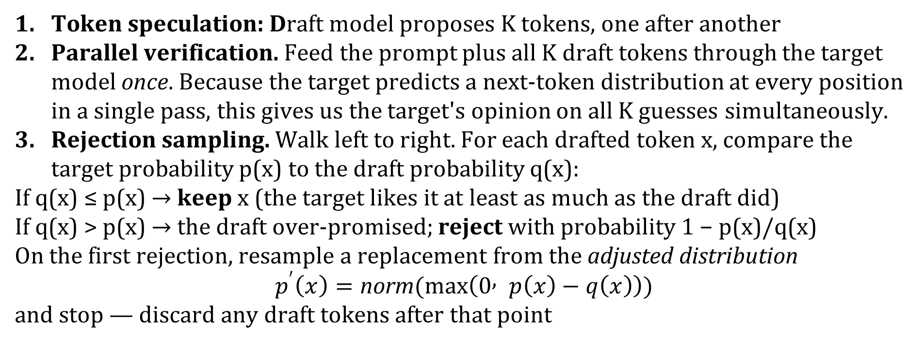
Three steps
Token speculation: Draft model proposes K tokens, one after another
Parallel verification. Feed the prompt plus all K draft tokens through the target model once. Because the target predicts a next-token distribution at every position in a single pass, this gives us the target's opinion on all K guesses simultaneously.
Rejection sampling. Walk left to right. For each drafted token x, compare the target probability p(x) to the draft probability q(x):
If q(x) ≤ p(x) → keep x (the target likes it at least as much as the draft did)
If q(x) > p(x) → the draft over-promised; reject with probability 1 − p(x)/q(x)
On the first rejection, resample a replacement from the adjusted distribution
$$p^{′}\left(x\right)=\text{norm}(max⁡\left(0 , p\left(x\right)−q\left(x\right)\right))$$
and stop — discard any draft tokens after that point

Slide 43
Example
two phases
Setup. Prompt so far: "The cat sat on". The draft model proposes K = 3 tokens. The target model verifies all three in one forward pass. Tiny vocabularies so every number is checkable by hand. The accept/reject rule looks only at the one token the draft actually sampled at each position
p(x) = target probability
q(x) = draft probability
p'(x) = adjusted distribution for resampling
Position 1 — context "The cat sat on"
Draft LLM sampled x = "the".
We need only that token's two probabilities:
p(the) = 0.60 and q(the) = 0.50
Since q(the) = 0.50 ≤ p(the) = 0.60, we are in the keep branch — no coin needed
→ Emit "the". Move to the next position

Slide 44
Example
Position 2 — context "The cat sat on the"
Draft sampled x = "mat":
p(mat) = 0.30 and q(mat) = 0.50
Now q(mat) = 0.50 > p(mat) = 0.30, so we are in the reject branch.
Compute the reject probability:
reject probability = 1 − p(mat)/q(mat) = 1 − 0.30/0.50 = 1 − 0.60 = 0.40
Flip a coin biased to reject 40% of the time.
Draw u uniform in [0,1];
reject if u < 0.40
This run: u = 0.25, and 0.25 < 0.40, so we reject
Because we rejected, we resample one replacement token from p'(x) = norm(max(0, p − q)

Slide 45
Example
This single distribution is defined over the whole vocabulary (a distribution must cover every token to be sampled from):
Assume only 4 token in vocabulary (floor, mat, rug, lawn)
→ Emit "floor“
STOP — discard any draft tokens proposed after this position (position 3 is never used, because the chain broke here).
token | p(x) | q(x) | max(0, p − q) | p'(x) after norm | Replacement chance
floor | 0.50 | 0.20 | 0.30 | 0.30 / 0.35 = 0.857 | 85.7% chance
mat | 0.30 | 0.50 | 0 | 0 | No chance
rug | 0.15 | 0.30 | 0 | 0 | No chance
lawn | 0.05 | 0.00 | 0.05 | 0.05 / 0.35 = 0.143 | 14.3% chance
normalizer is
Z = Σ max(0, p − q)
= 0.30 + 0 + 0 + 0.05
= 0.35

Slide 46
Example
Position 3 — context "The cat sat on the mat"
This position is not reached this iteration. The draft had proposed a token here, but a rejection at position 2 discards everything downstream. (draft's guess here is wasted work, which is why a good draft model — high acceptance — matters for speed.)
Result of this iteration
  "The cat sat on" + [ the, floor ] → 2 tokens emitted
  Two tokens generated from one target forward pass (plus three cheap draft passes).
Next iteration starts fresh from "The cat sat on the floor",
Draft proposes another K tokens, and the loop repeats.

Slide 47
Example
What each position demonstrated
Position | Drafted | Branch | Coin? | Outcome
1 | the | q ≤ p | no | keep “the”
2 | mat | q > p, reject 0.40 | u=0.25 → reject | resample → “floor”, then stop
3 | — | — | — | never reached (discarded)
Check the drafted token only. If the target likes it as much as the draft did (q ≤ p), keep it free.
If the draft over-promised (q > p), keep it with probability p/q;
otherwise reject, resample the replacement from the leftover p' = norm(max(0, p − q)), and stop.
The replacement can only be a token the target wanted more of than the draft offered

Slide 48
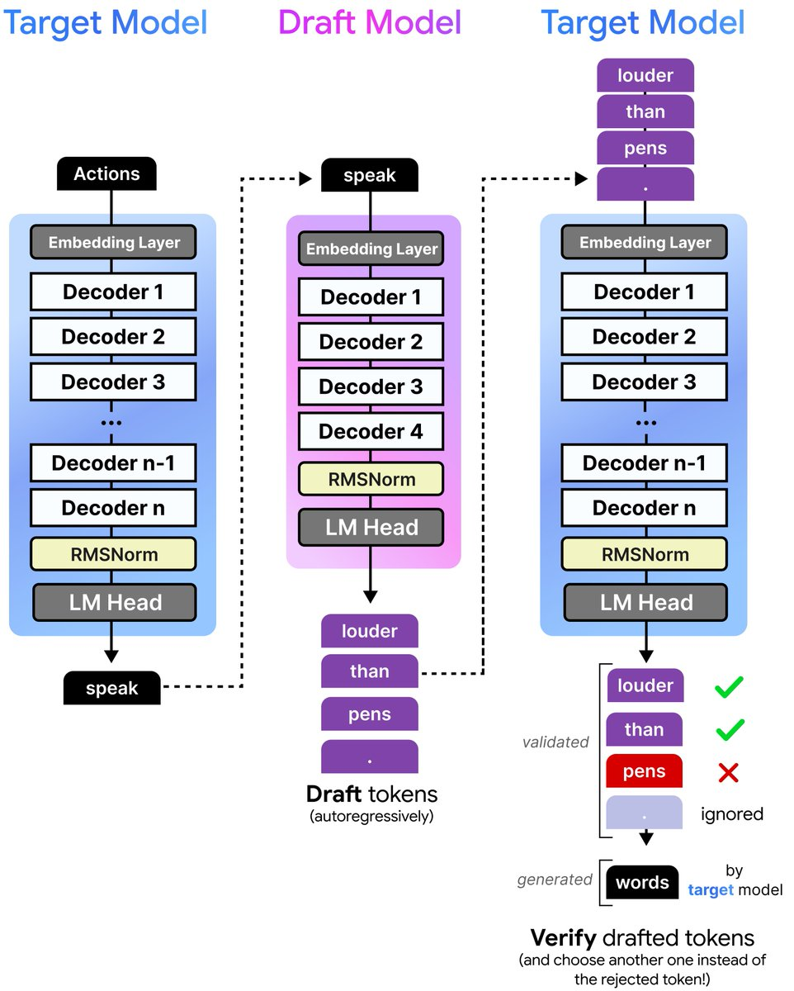
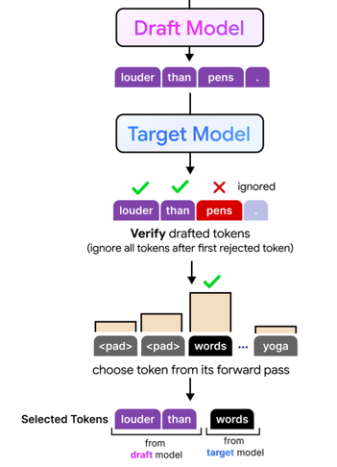
Gemma 4 - Drafter
Gemma 4 includes lightweight autoregressive drafter models that work with the main target models, proposing several likely next tokens while the larger model handles one verification step
Draft models has Multi-Token Prediction (MTP) head
https://x.com/googlegemma/status/2051694045869879749

Slide 49
PagedAttention
PagedAttention is the core memory-management technique introduced by and built into vLLM, which uses it to pack many more requests onto a GPU at once
PagedAttention stores KV cache in fixed-size non-contiguous blocks instead of one large contiguous buffer.
A block table maps logical token positions to physical GPU memory blocks.
Attention still works over the full context because the model gathers all needed KV blocks during decoding.
Result: less fragmentation, less wasted memory, more concurrent requests, and higher inference throughput
vLLM is a popular open-source library for fast, high-throughput LLM inference and serving, originally developed at UC Berkeley, whose headline innovation is PagedAttention

Slide 50
Static KV Cache Management Wastes Memory
Serving "request" one inference call — a single user prompt that model is actively generating a reply for
A serving system runs many of these concurrently, and each one holds its own KV cache
We don't know in advance how long each reply will be: chatbot greeting (80 tokens), long essay (1900)
Reserving each request a contiguous block sized for the max possible length (say 2048 tokens) up front causing possibly an internal fragmentation, e.g. Request used 200 of 2048
Suppose free memory left over is scattered into gaps (600 + 400 + 300 = 1300 tokens total free). That's more than enough memory in aggregate — but a new request needs 2048 contiguous tokens, and no single gap is big enough causing possibly an external fragmentation

Slide 51
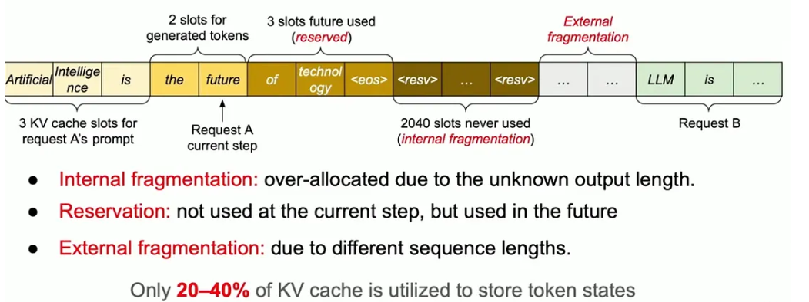
Static KV Cache Management Wastes Memory
Inage credits: https://medium.com/my-musings-with-llms/understanding-kv-cache-and-paged-attention-in-llms-a-deep-dive-into-efficient-inference-62fa372432ce

Slide 52
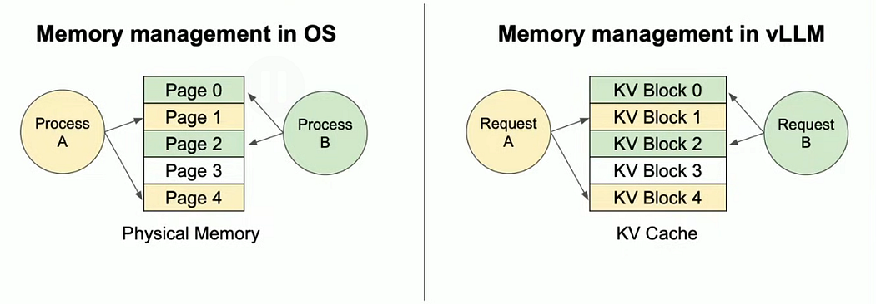
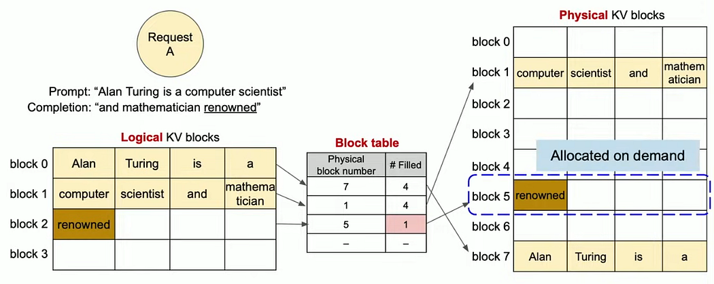
PagedAttention
https://pub.towardsai.net/paged-attention-turning-the-page-on-transformer-memory-f394ca74e230

Slide 53
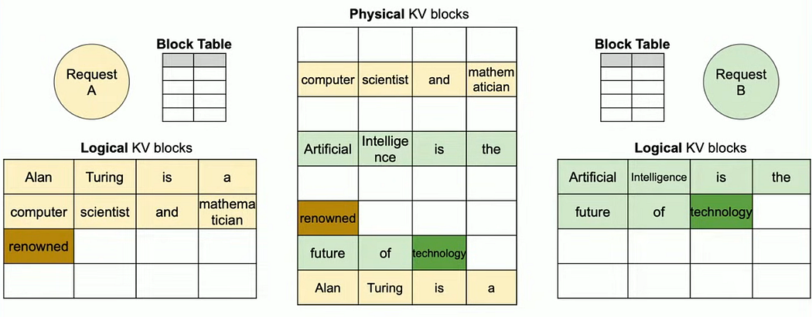
PagedAttention
https://pub.towardsai.net/paged-attention-turning-the-page-on-transformer-memory-f394ca74e230

Slide 54
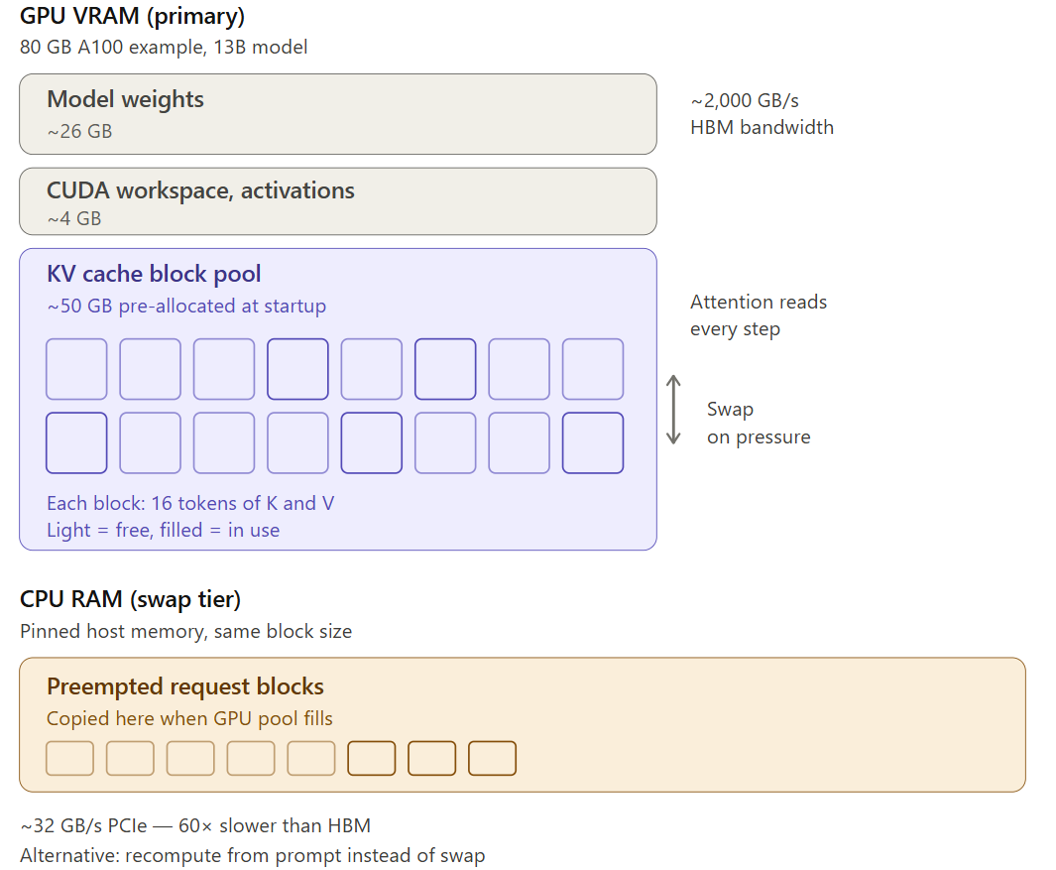
PagedAttention
PagedAttention stores the KV cache as fixed-size blocks drawn from a shared GPU memory pool rather than assigning each request one contiguous KV region
This improves memory utilization and throughput for variable-length requests
Under memory pressure, requests may be preempted; in modern vLLM, recomputation is usually favored over CPU swapping because data movement is often the more expensive path

Slide 55
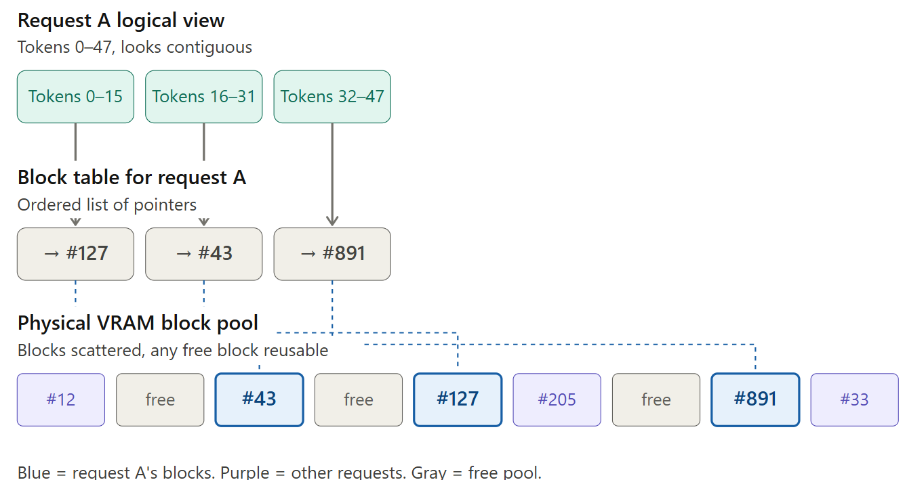
PagedAttention
A per-request block table maps logical token positions to physical KV blocks, allowing the cache to grow dynamically with minimal fragmentation.

Slide 56
References
https://research.google/blog/looking-back-at-speculative-decoding/
https://x.com/googlegemma/status/2051694045869879749
Research Papers
Fast Transformer Decoding: One Write-Head is AllYou Need
Fast Inference from Transformers via Speculative Decoding
Efficient Memory Management for Large LanguageModel Serving with PagedAttention

